Slide 1
Emergency Medical Service
Project Members:
Sadik Ittesaf abir : 1931595042
Sumit saha : 1931415042
Jannatul ferdous sristy : 1931533042
Abu Zafer MD fahim :

Slide 2
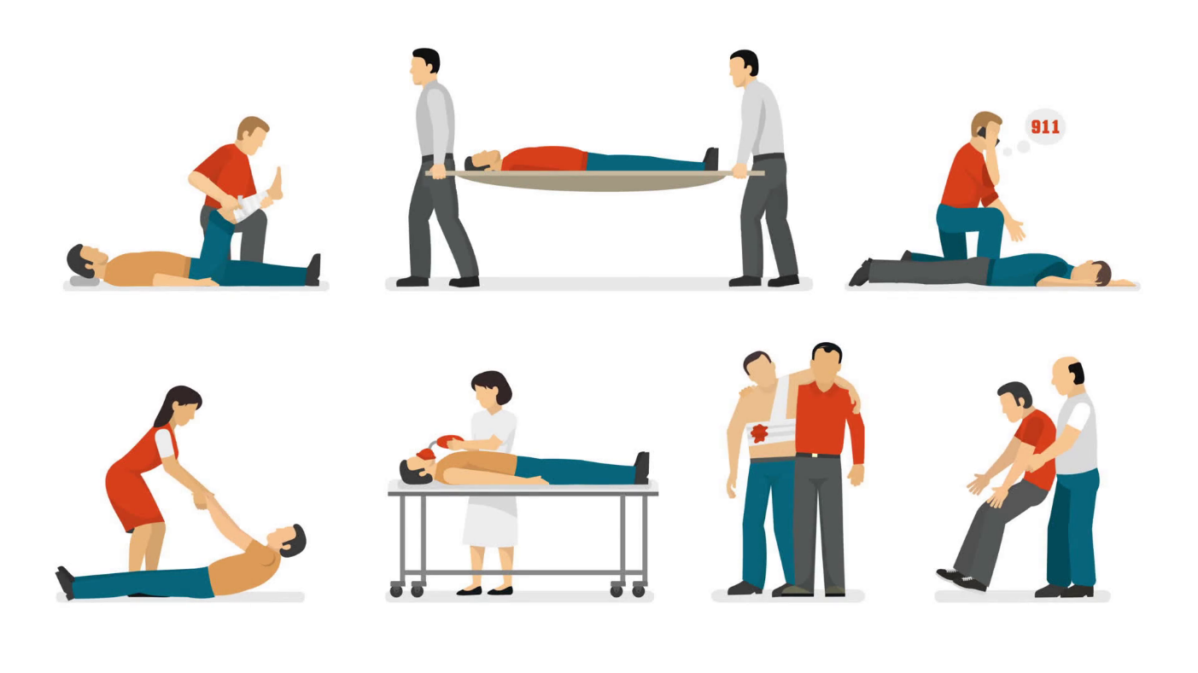
Target Audience
Emergency Medical Services is a system that provides emergency medical care. Our target audience are patients of all ages who need instant care. We’re also providing part time jobs for the Doctors, Drivers who are willing to help these patients. This App will provide service for patients from all across the country. We also provide blood donors for people who need them.

Slide 3
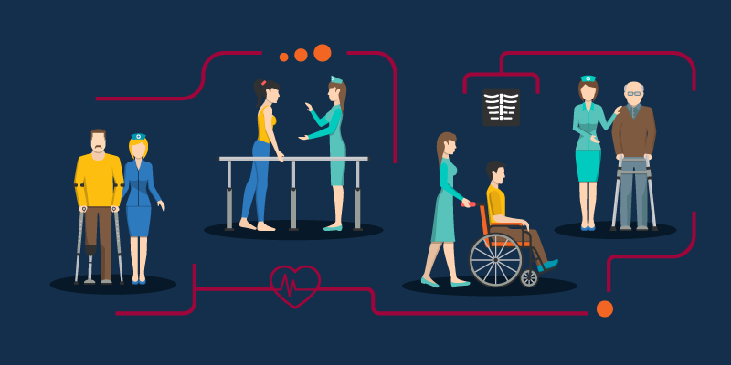
Our App will Full-fill these Medical Needs
We’re going to provide transport for patients who need this service immediately
We help the patients to make their appointments online
Provide blood donors for patients who need them.
Provide services for elderly people who need check up at regular intervals

Slide 4
Problems we are solving
Sometimes it’s difficult to get ambulance on time.
Patients need to physically go to the hospital to get appointments.
Sometimes finding a blood donor can be difficult.

Slide 5

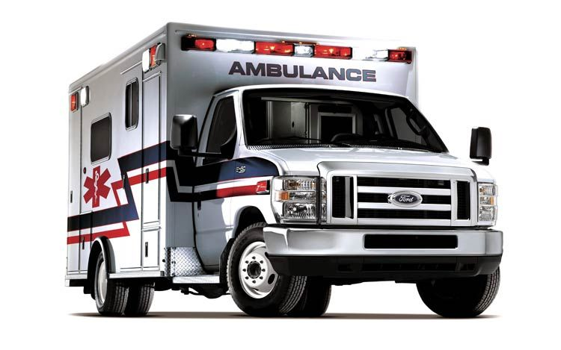
Opportunity
Providing part time jobs for the nurses and drivers.
It can be a platform where user can get all types of doctors easily
Our system will be well scheduled so that patient doesn’t have to wait for long
By API we can use patient’s location so that our transport service will get quicker.

Slide 6
Is the project’s purpose and basic functionality easily understood?
Login/user register
Login/register for users
Search donor, nurses, riders
Payment method
Search patients locations and details
Post available doctor’s schedule
Make appointments
Patients
Donors,
drivers,nurse
Patients
Search Patient’s Location & details
Post available doctor’s,donors,drivers schedule
Chat & Fix time
Payment

